Slide 1


CAPSTONE PROJECT
EXPLORATORY DATA ANALYSIS HOTEL BOOKING
EXPLORATORY DATA ANALYSIS ON HOTEL BOOKINGS
BANAVATH GANESH
BANAVATH GANESH

Slide 2
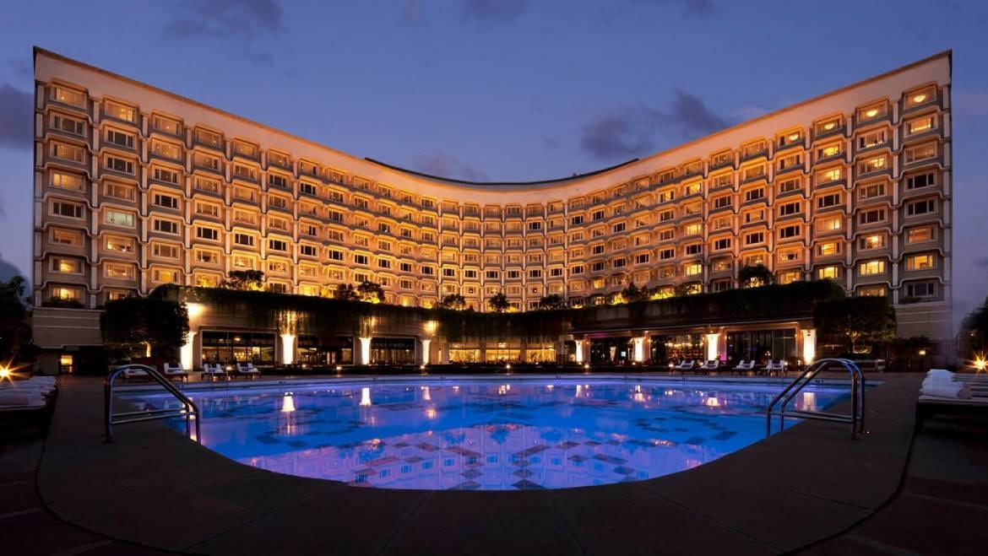
HOTEL BOOKING ANALYSIS
1) Defining the problem statement
2) Importing the Libraries
3) Missing value Imputation
4) Descriptive Statistics
5) Graphical Representation

Slide 3
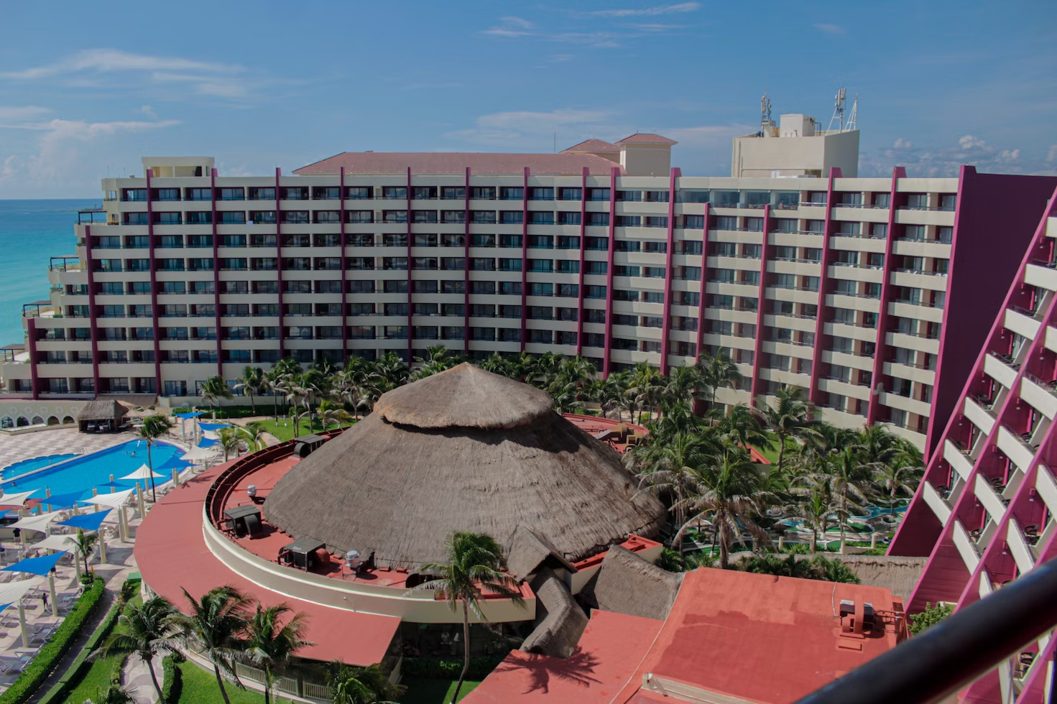
PROBLEM STATMENT
Have you ever wondered when the best time to book a hotel room is? What if you wanted to predict which hotel likely to receive high number of special requests?
This Dataset contains data that compares various booking information between two hotels, City Hotel and Resort Hotel. We will be using the data to analyze the factors affecting the hotel bookings. These factors can be used for reporting trends and predict the future bookings.
This dataset contains the booking data of hotels from year 2015-2017.

Slide 4

DATA ANALYSIS STEPS
Import Libraries:
In this part, we had imported the required libraries to perform Exploratory Data Analysis for the Hotel booking dataset.
Descriptive Statistics:
In this part, we start by looking at descriptive statistic parameters for the dataset. We will use describe() for this
Missing Value Imputation:
We will now check for missing values in our dataset. In case there are any missing entries, we will impute them with appropriate values
Graphical Representation:
We will start with the Univariate analysis where the data will be analyzed only one variable. Where as Bivariate analysis ,the data will be compared with two variables to study their relationships. Multivariate analysis is similar to bivariate analysis but comparing more than two variables. .

Slide 5
POINTS FOR DISCUSSION
We have explored the following points while doing this analysis – The following steps are below:
1) What is the most preferred Hotel by the customers?
2) Which month has the most peak customer flow or the bookings.
3) What is the most preferred meal by the customers in Hotel ?
4) Which country has the highest number of hotel bookings?
5) Which market segment has the highest volume of hotel bookings?
6) What are the main distribution channels for hotel bookings?
7) What are the different types of rooms that are typically assigned to customers, and which room type is most preferred by customers?
8) Which deposit type contribute more to the business?
9) Which type of customer has the highest value in terms of hotel bookings?
10) What is the highest count in the reservation status?
11) What is the reservation status date for hotel bookings?
12) How many reservations are is canceled and not canceled?
13) Among three years which year has the peak customer flow?
14) Are there any outliers present in the stays_in_weekend_nights?
15) Among three years which month has the peak customer flow?
16) How many customers are arriving with babies in their hotel bookings?
17) How many customers are arriving as adults in the hotel bookings?
18) Is there any potential for business in ‘excess car parking space’ ?
19) Which year contributes the year wise city and resort hotel?
20) From which hotel has more number of cancelations and not cancelations?
21) Are there any outliers present in the lead time, indicating instances where there is a significant delay between the booking date and the arrival date?
22) Which month has more number of Bookings?
23) What is the Average daily rate in city and resort hotel?
24) Which country has the highest preference for a specific type of meal?
25) What conclusions can be drawn from the analysis regarding the relationship between the variables 'Market Segment,' 'Lead time,' and 'Hotel'?

Slide 6
Attributes of each variable:
hotel - H1 = Resort Hotel H2 = city Hotel
is_Cancelled - If the boking was Cancelled (1) or Not (0)
lead_time - Number of days that elaped between the entering date of the booking into the PMS and the arrival date
arrival_date_year - Year of arrival date
arrival_date_month - Month of arrival date
stays_in_weekend_nights - Number f weekend night (Saturday or Sunday) the guest stayed or booked to stay at the hotel
adults - Number of adults
children - Number of children
babies - Number of babies
meal - Kind of meal opted for
country - Country code
market_segment - Which segment the customer belongs to
distribution_channel - How the customer accessed the stay corporate booking / direct / TA.TO
is_repeated_guest - Guest coming for first time or not
previous_cancellation - was there a cancellation before
previous_bookings - count of precious bookings
reserved_room_type - Type of room reserved
Room type A = A room assigned for adults.
Room type D = A Room with two double beds.
Room type E = Executive Room: a hotel room more orientated towards business (executive) guests. Usually with a desk or space for guests to get some work done.
Room type F = A room assigned to four people.
Room type G = GOOD ROOM.

Slide 7
Room type C = Connecting rooms
Room type B = Bunk Room: has beds in bunk–style
Room type H = A room that can accommodate two persons with two twin beds joined together by a common headboard.
Room type L = Luxury rooms.
Room type P = Presidential Suite.
assigned_room_type - Type of room assigned
booking_changes - count of changes made to booking
agent - Booked through agent
days_in_waiting_list - NUmber of days in waiting list
cutomer_type - Type of customer
required_car_parking - if car parking is required
total_of_special_req - Number of additional special requirement's
reservation_status - Reservation of status
reservation_status_date - date of the specific status

Slide 8
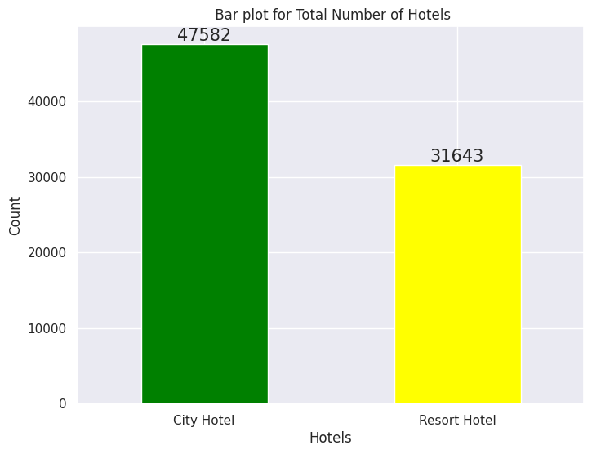
What is the most preferred Hotel by the customers?
The findings from the bar diagram highlight the higher popularity and demand for accommodations in the City Hotel compared to the Resort Hotel.
The bar diagram analysis indicates that the City Hotel received the highest number of bookings, with a count of 47,582.
In comparison, the Resort Hotel had a slightly lower count of 31,643 bookings.

Slide 9
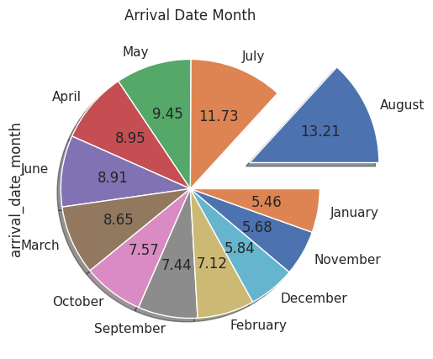
Which month has the most peak customer flow or the bookings
Among all the months, August has the largest share of arrival dates, indicating its popularity as a preferred time for bookings.
The pie chart analysis reveals that the month of August stands out with the highest percentage of arrival dates, accounting for 13.21% of the total.
Conversely, January exhibits the lowest percentage of arrival dates, comprising only 5.46% of the total

Slide 10
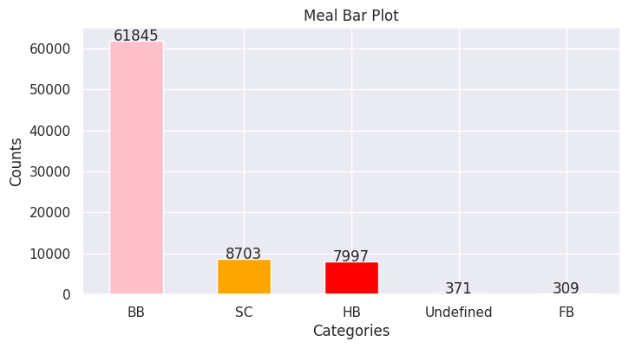
What is the most preferred meal by the customers in Hotel ?
The bar plot provides insights into the meal preferences of customers based on the counts for each option.
The BB (Bed and Breakfast) option stands out as the most preferred choice among customers, with a count of 61845.
On the other hand, the FB (Full Board) option appears to be the least preferred, with a significantly lower count of 309.

Slide 11
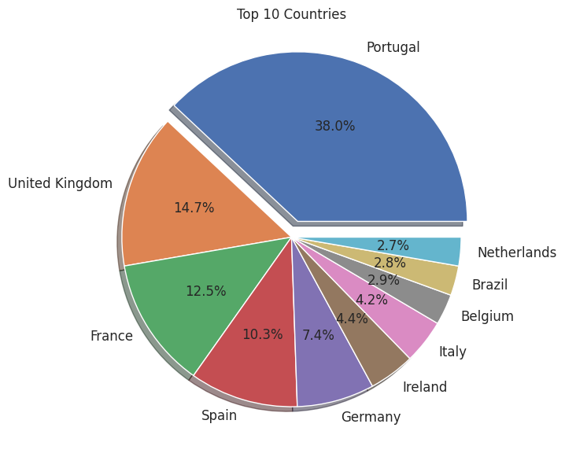
Which country has the highest number of hotel bookings?
The pie chart visualizes the top 10 countries with the highest hotel bookings.
Portugal accounts for a significant portion, specifically 38.0%, of the total bookings.
Among the top 10 countries, Portugal has the highest percentage of hotel bookings.
The data clearly indicates that Portugal is the most popular choice among travelers, based on hotel bookings.

Slide 12
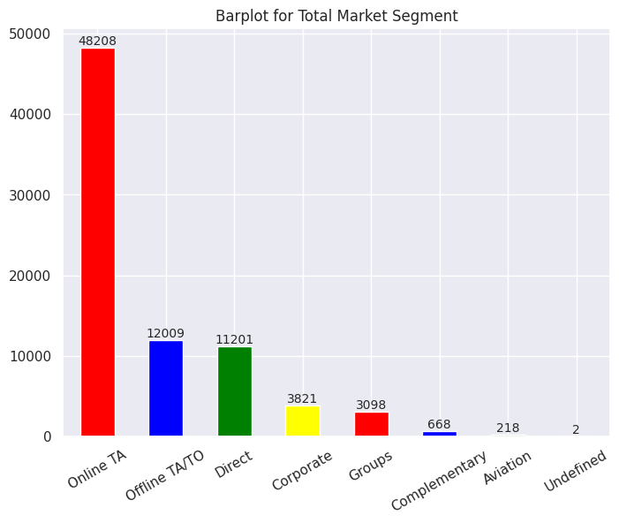
Which market segment has the highest volume of hotel bookings?
The online Travel Agency (TA) market segment has the highest number of customers.
The total count of customers in the online TA segment is 48,208.
The Aviation market segment has the lowest customer count among all the segments.
The customer count in the Aviation segment is 218.

Slide 13
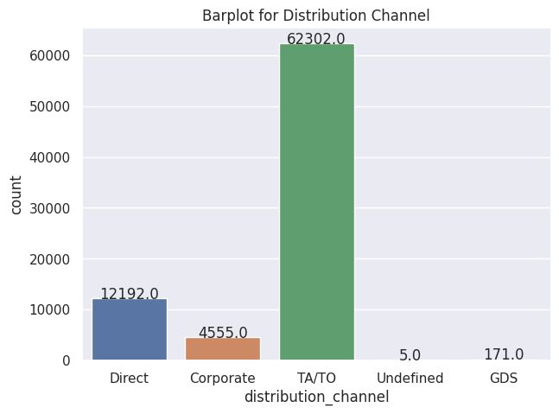
What are the main distribution channels for hotel bookings?
The Travel Agency/Tour Operator (TA/TO) channel is the most popular choice for customers when it comes to corporate booking stays.
The count of customers in the TA/TO channel is 62,302.

Slide 14
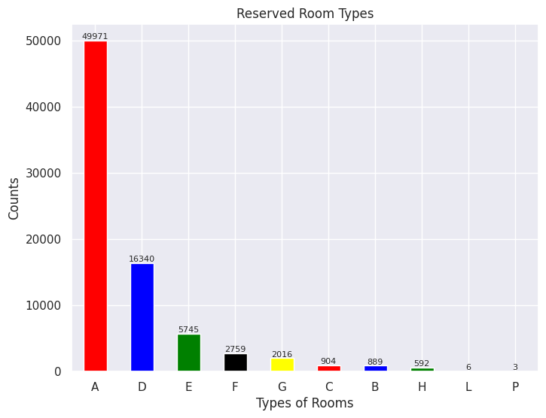
What are the different types of rooms that are typically assigned to customers, and which room type is most preferred by customers?
Based on the data shown in the bar graph The most preferred room type for reservations is Room Type A.
The count of reservations for Room Type A is 49,971.
Conversely, the least preferred room type is Room Type P. The count of reservations for Room Type P is only 3.

Slide 15
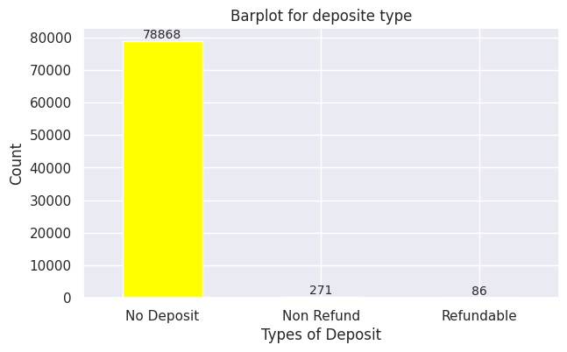
Which deposit type contribute more to the business?
The majority of customers did not make a deposit.
The count of customers who did not make a deposit is 78,868.
On the other hand, the lowest count is for customers who made a refundable deposit. The count of customers who made a refundable deposit is only 86.

Slide 16
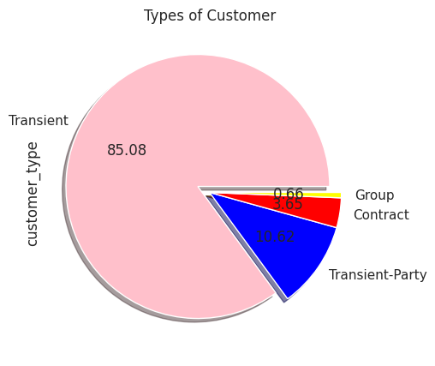
Which type of customer has the highest value in terms of hotel bookings?
The Transient category has the highest number of customers, accounting for 85.08%. The count of customers belonging to the Transient category is the highest among all categories.
Conversely, the Group category has the lowest number of customers, representing only 0.66%. The count of customers falling into the Group category is the lowest among all categories.

Slide 17
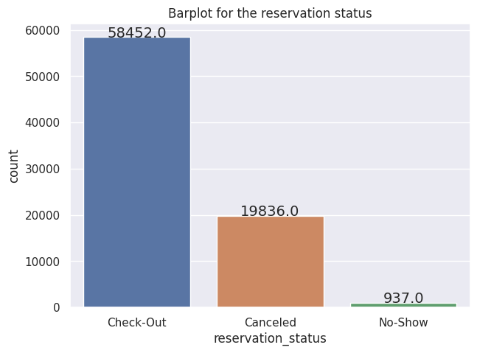
What is the highest count in the reservation status?
The bar plot indicates that the highest number of reservations occurs during check-out. The count of reservations for the check-out category is 58,452.
On the other hand, the lowest number of reservations is for the "no-show" category. The count of reservations for the "no-show" category is only 937.

Slide 18
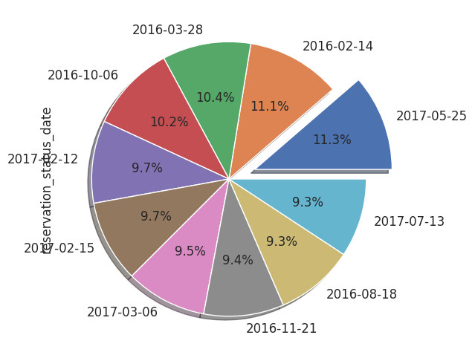
What is the reservation status date for hotel bookings?
Based on the information presented in the pie chart, it can be concluded that the reservation status date "2017-05-25" has the highest percentage of 11.3%. This date accounts for the largest portion of reservations among all the dates shown in the chart

Slide 19
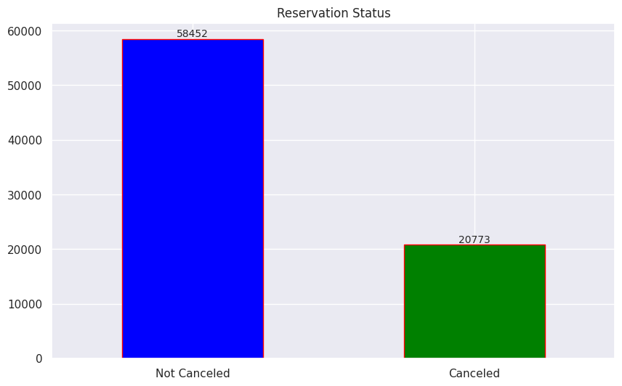
How many reservations are is canceled and not canceled?
From the bar plot, we can understand the reservation status as follows:
The count for "Not Canceled" reservations is 58,452.
The count for "Canceled" reservations is 20,773.

Slide 20
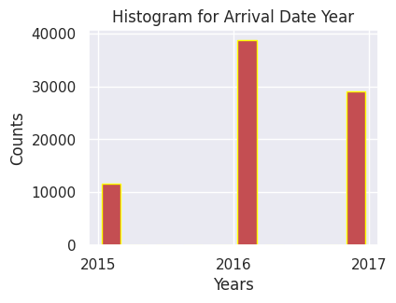
Among three years which year has the peak customer flow?
From the histogram In the year 2016 has the more customer flow or the highest booking year than 2015 and 2017.

Slide 21
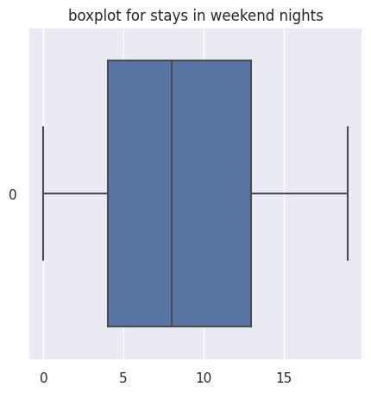
Are there any outliers present in the stays_in_weekend_nights?.
This boxplot represents the average of stays in weekend nights is 7.5
This boxplot shows that column don't have a outliers

Slide 22
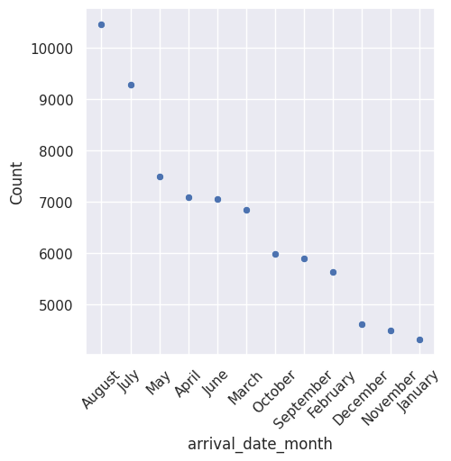
Among three years which month has the peak customer flow?
From the scatter plot, it can be concluded that the August had the most customer arrivals compared to other months.
Number of customers arrived in the month of August, with a count of 10,465.
January had the lowest customer arrivals compared to the other months with the count of 4324.

Slide 23
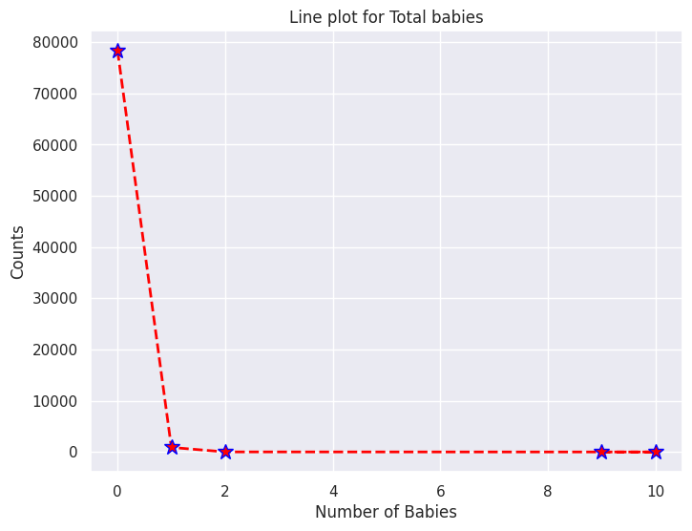
How many customers are arriving with babies in their hotel bookings?
From the line plot, it can be observed that the highest number of customers coming to the hotel are without babies (zero [0]), with a count of 78,314.
The second highest number of customers coming to the hotel are with one baby, with a count of 894.
only one customer is coming to the hotel with nine babies.

Slide 24
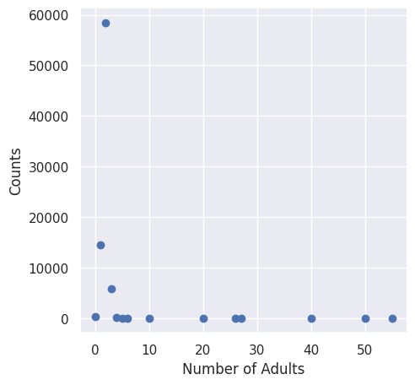
How many customers are arriving as adults in the hotel bookings?
Based on the scatter plot, it can be concluded that the highest number of customers coming to the hotel consists of two (2) adults. The count for this category is 58,474, indicating that it has the highest frequency of occurrences among the observed data points.
The second highest count of customers coming to the hotel comprises one (1) adult, with a count of 14,559.
The least frequency among the observed ten (10) adults, with a count of 1.

Slide 25
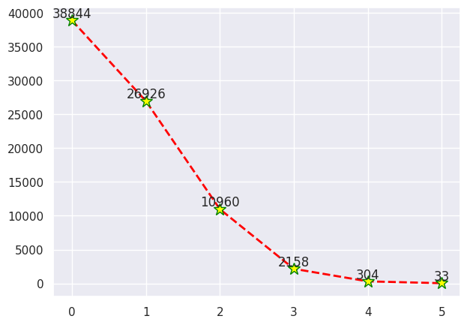
Is there any potential for business in ‘excess car parking space’ ?
The line plot shows, it can be concluded that the highest number of hotel bookings do not have any special requests. The count for bookings without any special requests is the highest among the observed data points with the count of 38844.
The least count of special requests in hotel bookings is five (5), with a count of 33. This indicates that bookings with five special requests have the lowest frequency among the observed data points.

Slide 26
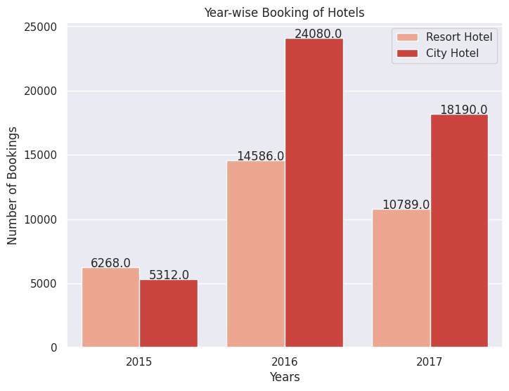
Which year contributes the year wise city and resort hotel?
Based on the Countplot, it can be concluded that in comparison to the years 2015 and 2017, the year 2016 had the highest number of hotel bookings in the city hotel category. The count for hotel bookings in the year 2016 in the city hotel category is 24,080.
The Countplot reveals that the lowest count of hotel bookings in the city hotel category is observed in the year 2015, with a count of 5,312.

Slide 27
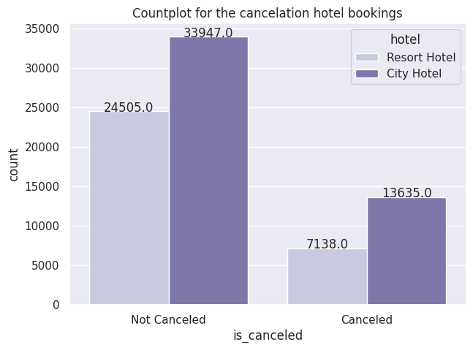
From which hotel has more number of cancelations and not cancelations?
The Countplot reveals that the city hotel has the highest count of not canceled bookings, with a count of 33,947, while the resort hotel has a slightly lower count of 24,505.
The city hotel has a higher count of canceled bookings, with a count of 13,635, while the resort hotel has a slightly lower count of 7,138, indicating a lower number of canceled bookings compared to the city hotel.
The reason why the city hotel had the highest count of canceled bookings is because it also had the highest number of total bookings. Since the city hotel received a larger number of bookings overall, it naturally resulted in a higher count of cancellations compared to the resort hotel.

Slide 28
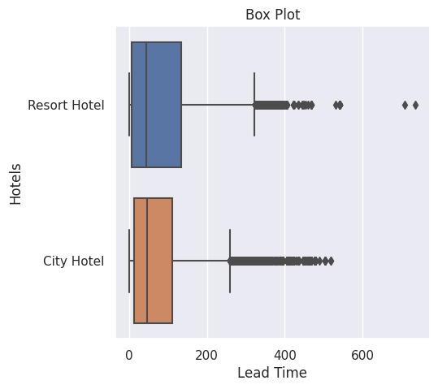
Are there any outliers present in the lead time, indicating instances where there is a significant delay between the booking date and the arrival date?
This box plot represents the average Lead time of two hotels.
This box plot shows that have a outliers in this.
Most of the outliers from 300 to 600

Slide 29
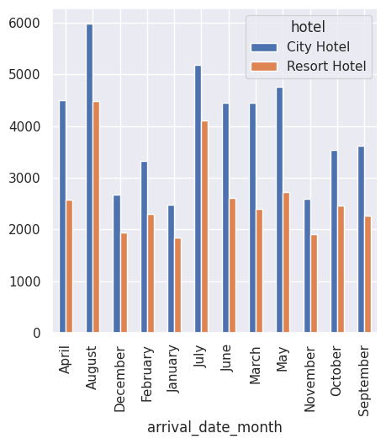
Which month has more number of Bookings?
According to the bar plot, it is evident that the month of August had the highest count of bookings in the city hotel compared to all other months.
This indicates that August was the most popular month for bookings in the city hotel.
The month of January had the lowest count of bookings in the resort hotel compared to all other months.
This suggests that January had the least number of bookings in the resort hotel.

Slide 30
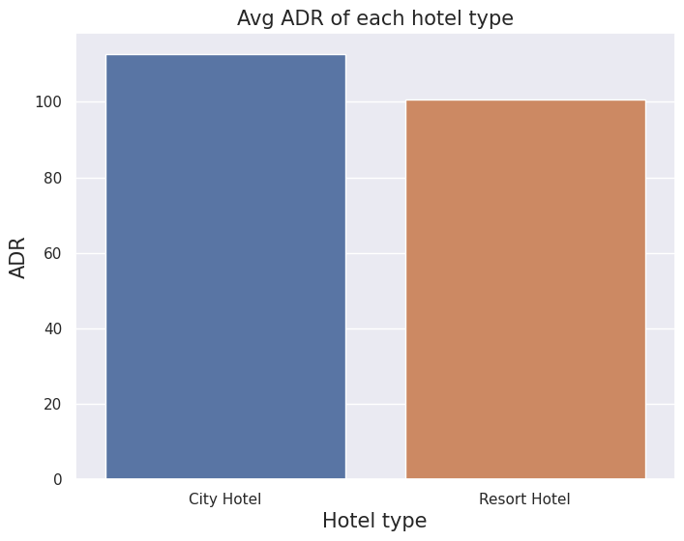
What is the Average daily rate in city and resort hotel?
Based on the bar plot, it can be observed that the City Hotel has a higher count in the Average Daily Rate (ADR) compared to the Resort Hotel. This indicates that the City Hotel has a larger number of bookings with a higher ADR value, while the Resort Hotel has a relatively lower count in the ADR category.

Slide 31
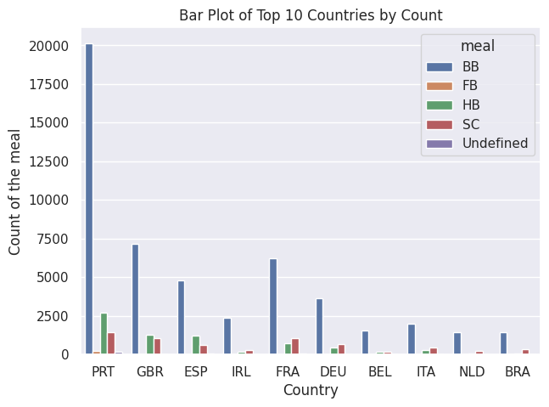
Which country has the highest preference for a specific type of meal?
Based on the count plot, it can be concluded that in Portugal, the majority of meals served in hotels are breakfast (BB) compared to all other meal types. The count of breakfast meals is the highest among the observed data points, indicating that it is the most common meal option chosen by guests in Portugal.

Slide 32
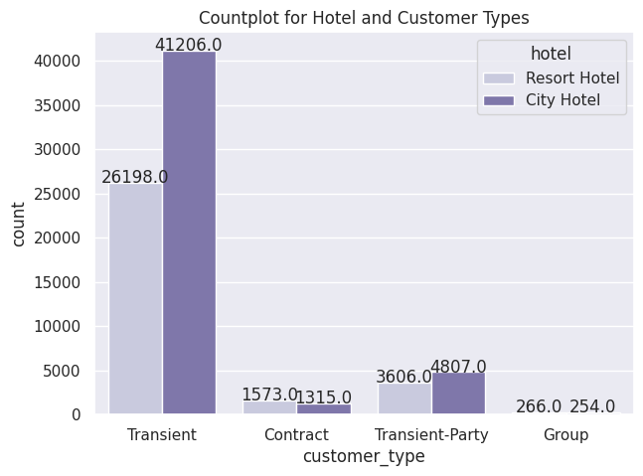
Which customer type impacted the business City hotel or Resort hotel?
Based on the barplot, we can infer that the majority of customers belong to the transient customer type. They exhibit a higher preference for city hotels compared to resort hotels, as indicated by a count of 41,206 customers.
The group type customers have the lowest representation in both city and resort hotels. Specifically, there were only 254 group type customers recorded in city hotels and 266 in resort hotels.

Slide 33
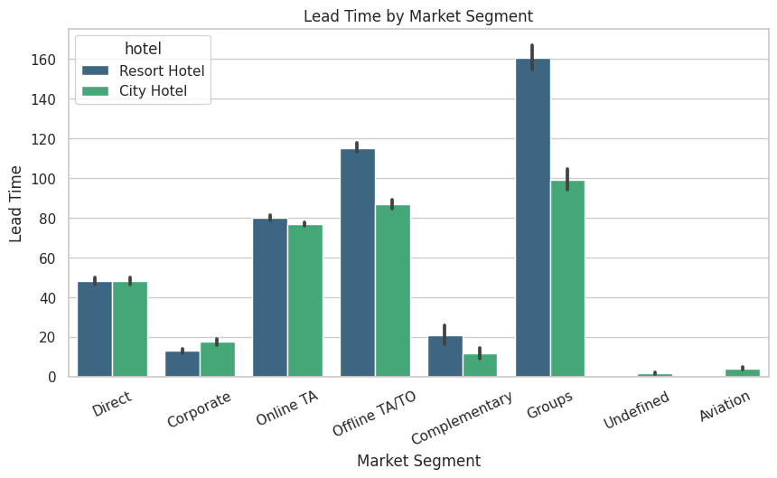
What conclusions can be drawn from the analysis regarding the relationship between the variables 'Market Segment,' 'Lead time,' and 'Hotel'?
The provided barplot visually presents a multivariate analysis that specifically explores the relationship between the variables "Market Segment," "Lead_time," and "Hotel,’’.
According to the barplot, it is evident that a majority of the customers belong to the "Groups" segment. Additionally, within the "Resort" hotel category, customers from the "Groups" segment tend to have a higher lead time compared to other market segments.
The barplot indicates that customers from the "Direct" segment have similar lead times for both city and resort hotels.
The "Undefined" segment exhibits the lowest or shortest lead time for both city and resort hotels.

Slide 34
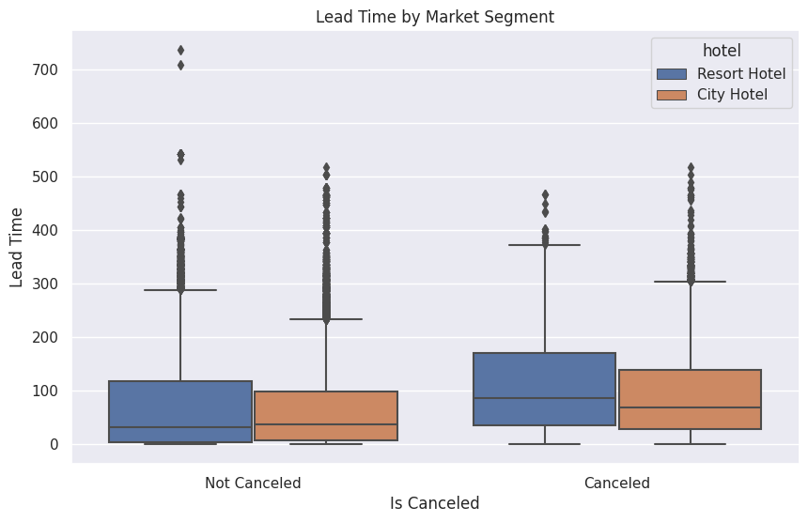
What is the relationship between hotel cancellations and lead time?
The boxplot shows that "highest bookings are canceled in the resort hotel" indicates that a significant number of bookings made for the resort hotel are subsequently canceled.
The resort hotel demonstrates the highest rate of successful bookings with minimal cancellations,
The boxplot analysis of lead time for the resort hotel reveals the presence of outliers, indicating that there are exceptional cases with significantly longer lead times compared to the majority of bookings.
Customers show a stronger tendency to plan ahead for bookings at the resort hotel, leading to a higher number of outliers in the lead time distribution.

Slide 35
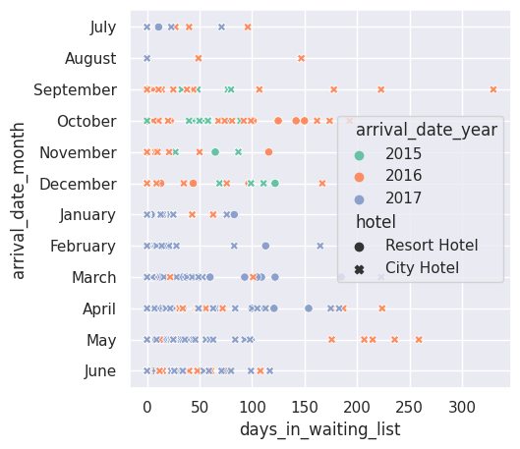
What is the relationship between the variables 'Days in waiting list,' 'Arrival month,' 'Arrival year,' and ‘hotel' based on the analysis?"
The scatter plot above depicts a multivariate analysis focusing on the relationship between the variable "Days in waiting list" and other factors.
The majority of the days in the waiting list were observed in the year 2017, as compared to the years 2015 and 2016
it can be observed that the year 2015 had the fewest number of days in the waiting list compared to other years.
The majority of the days in the waiting list were observed during the month of October, compared to all other months.
it can be observed that the month of August had the fewest number of days in the waiting list compared to other months.
it is evident that the majority of the days in the waiting list occurred in the city hotel, in comparison to the resort hotel.

Slide 36
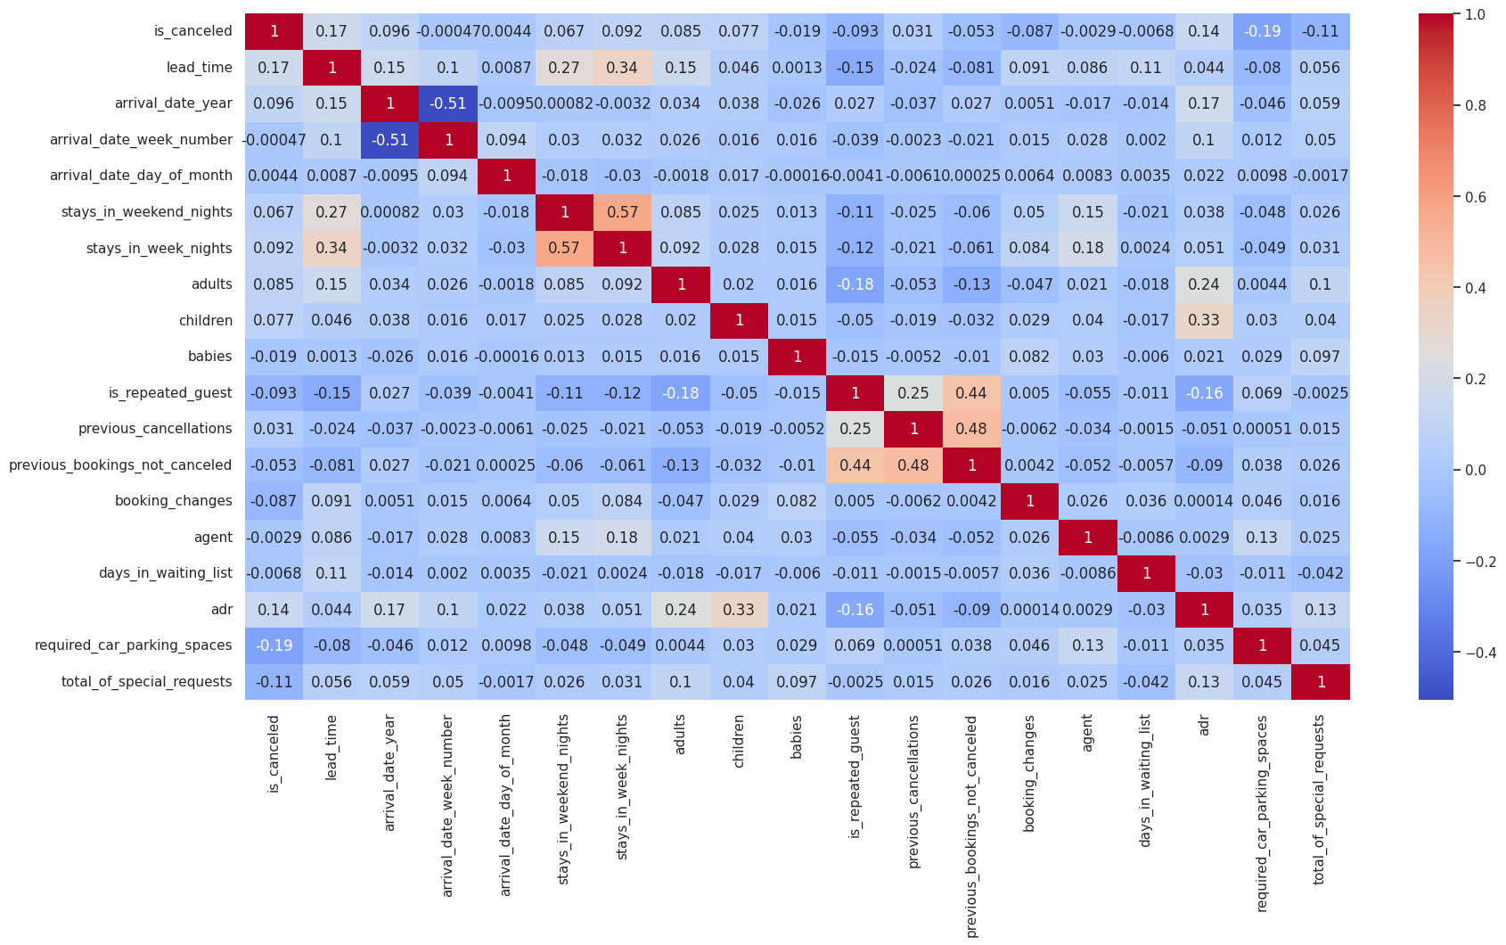

Slide 37
CONCLUSIONS
City Hotel is the most preferred hotel by the customers.
City Hotel seems to be more preferred among travelers and it also generates more revenue and profit.
Year 2016 is highest booking year with total booking of 56,707 then booking decreased to 40,687.
The percentage of City hotel is 66.45% while the percentage of Resort Hotel is 33.55% is used to stay.
August is the month or we can say that the time of the year in which hotel booking is at its peak. And January is the month in which hotel bookings are least
Weekdays have more number of bookings than Weekends.
From both the hotels City and Resort , No Deposit type is more in count which means it contributes more value and percentage to get the revenue for the business.
The City Hotel has the more number of count in the Average Daily Rate than Resort Hotel.
The more number of canceled and not canceled in City Hotel is more than the Resort Hotel.
Most of the customers required no parking space ,only less then 10 percentage people required car parking space
The Most preferred meal by the customers is BB(bed and breakfast )which is around 77.8%. FB is least preferred.
The people of Portugal(PRT) id doing maximum numbers of bookings .

Slide 38
Solution to Business Objectives
To attain high growth and more success , hotel business need to flourish and for that few things which we need to consider is high revenue generation , customers satisfaction and employee retention.
2. We found that performance in different categories like most liked meal type, facilities required by customers like car parking spaces etc. So , all these insights ultimately add to have a better planning for growth and higher revenue.
3. Periodically throw offers to attract old customers so as to increase the number of repeated guests.
4. To introduce system of getting feedback often from the guests visiting the hotels so that the quality can be upgraded to the next level to increase more guests.

Slide 39


Slide 40


